Slide 1
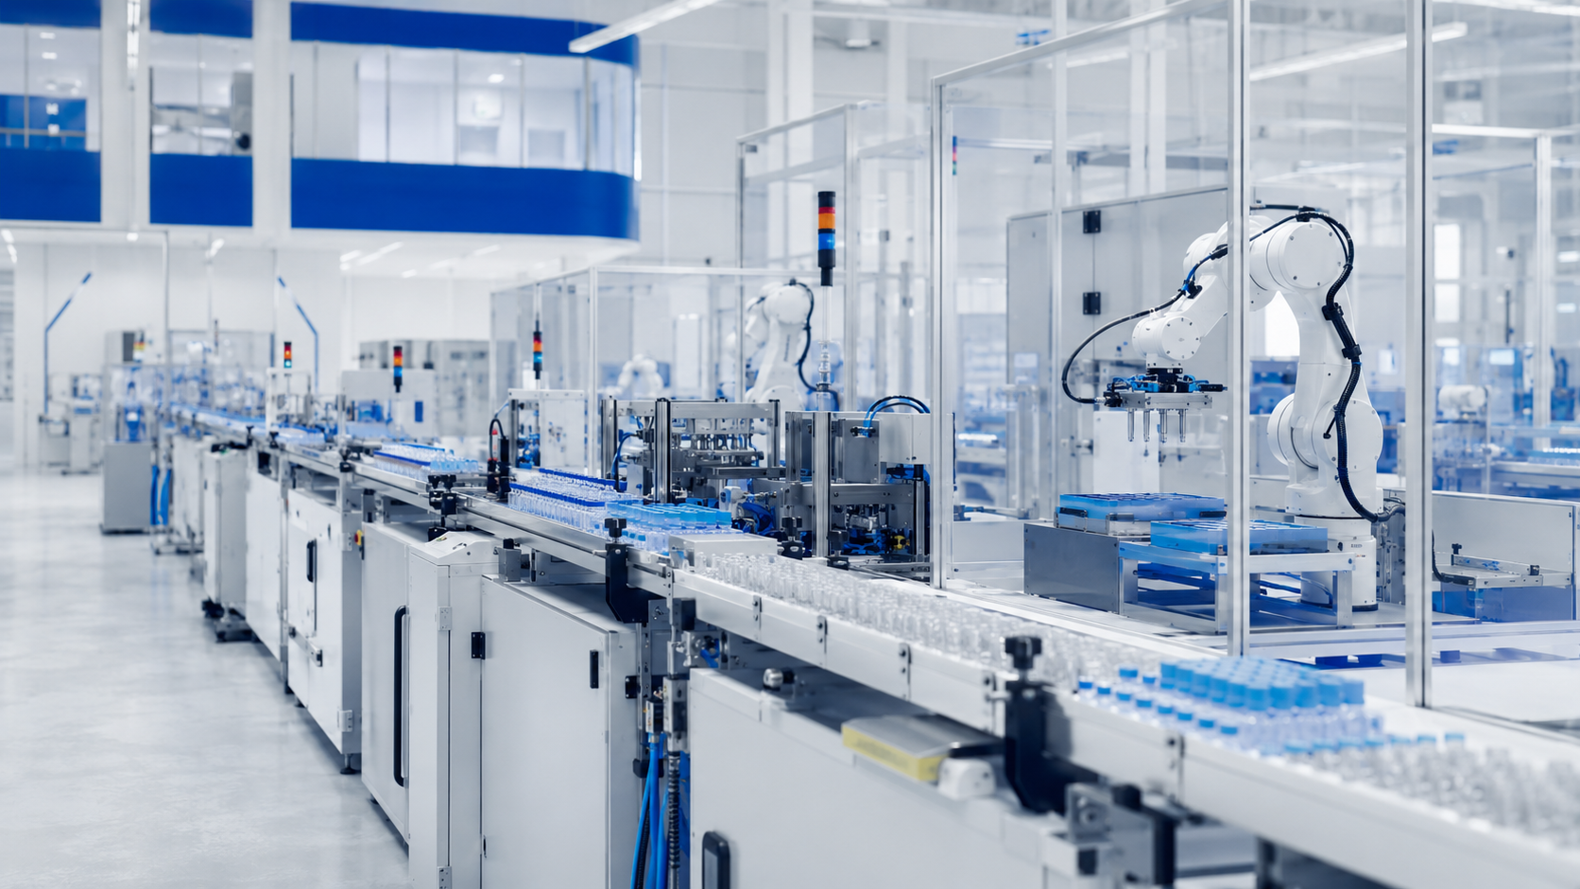

A Scalable Diagnostics Platform for Global Growth
Strategic partnership, localization and technology transfer.
visionbiotechnology.com
Notes:
[Sources]
- Vision Biotechnology website and project content: https://www.visionbiotechnology.com/
- Vision Biotechnology 2026 catalog (user supplied)

Slide 2
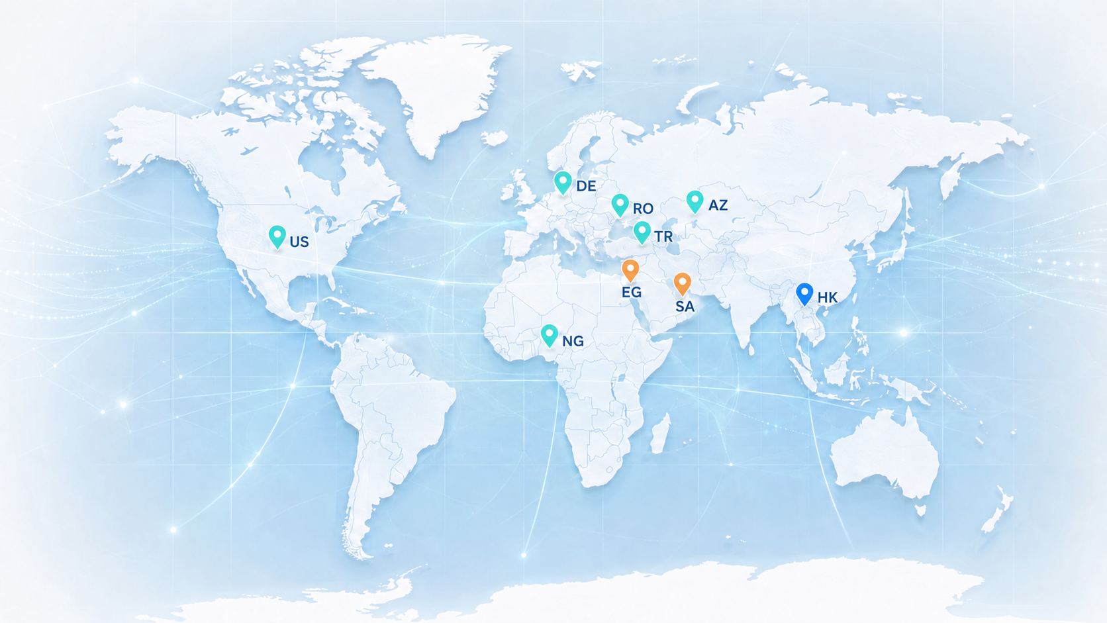
INVESTMENT THESIS
The opportunity is a platform—not a single product
Vision combines a diversified product base, connected instrument workflows, manufacturing know-how and regional localization models. Growth can be built through multiple, mutually reinforcing pathways.
VISION BIOTECHNOLOGY
02
Notes:
[Sources]
- Vision Biotechnology website and project content: https://www.visionbiotechnology.com/
- Vision Biotechnology 2026 catalog (user supplied)

Slide 3
OUR JOURNEY
Built through disciplined expansion, 2012–2026
2012
2018
2023
Founded in İstanbul, Kadıköy
IVD & molecular diagnostics
Veterinary diagnostics
2015
2020
2026
Domestic food-safety tests
COVID-19 RT-PCR & exports
Localization network
VISION BIOTECHNOLOGY
03
Notes:
[Sources]
- Vision Biotechnology website and project content: https://www.visionbiotechnology.com/
- Vision Biotechnology 2026 catalog (user supplied)

Slide 4
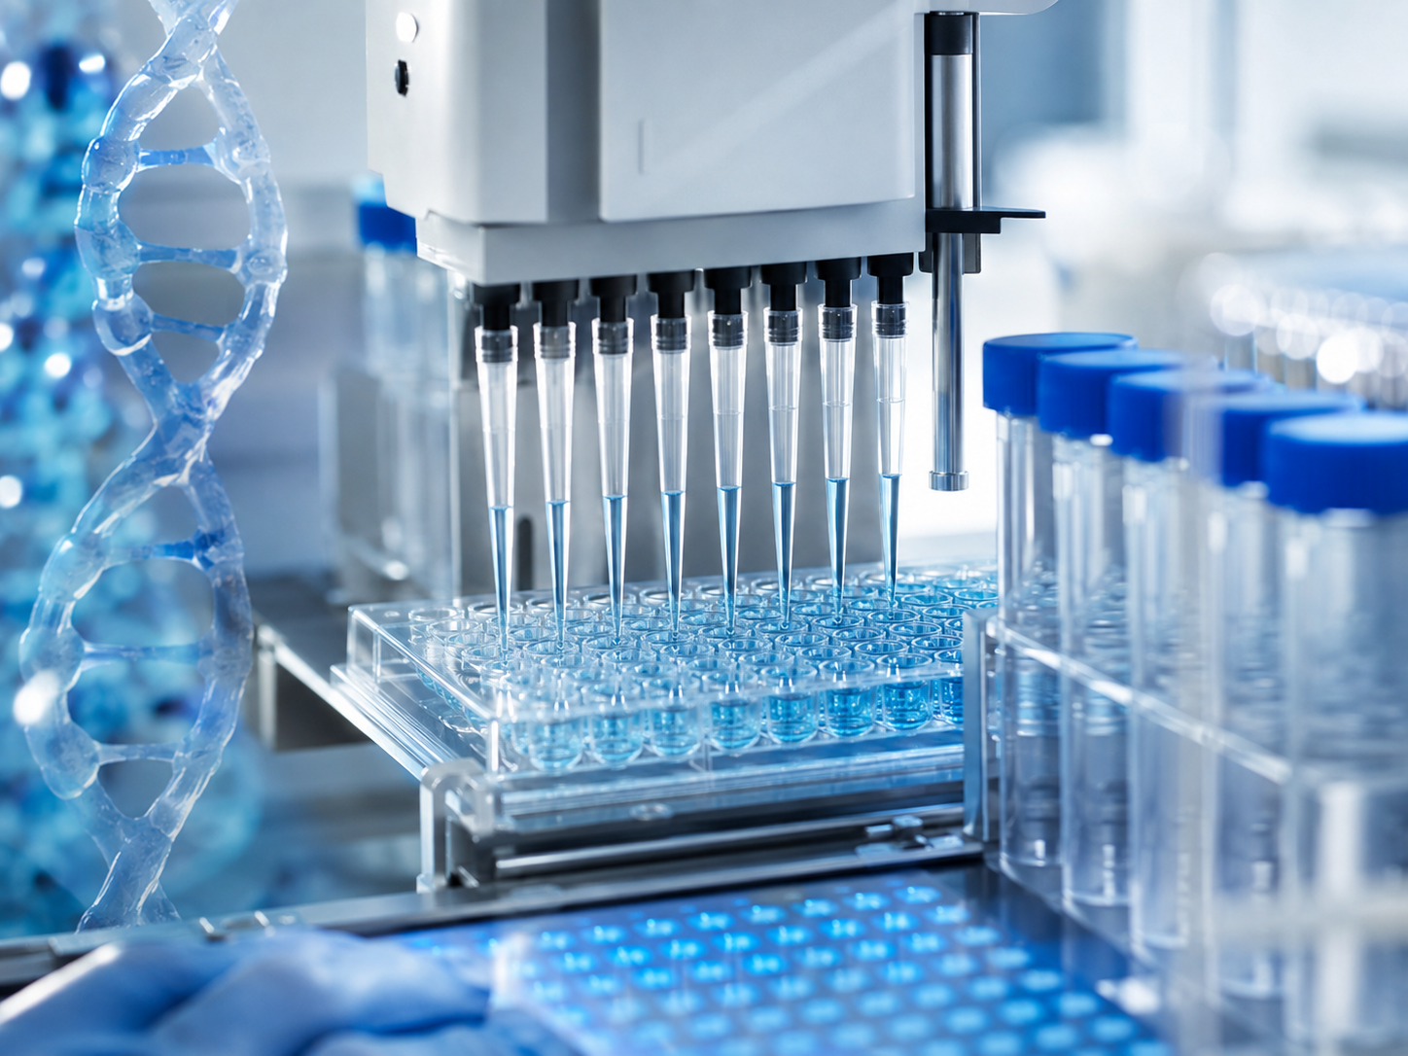
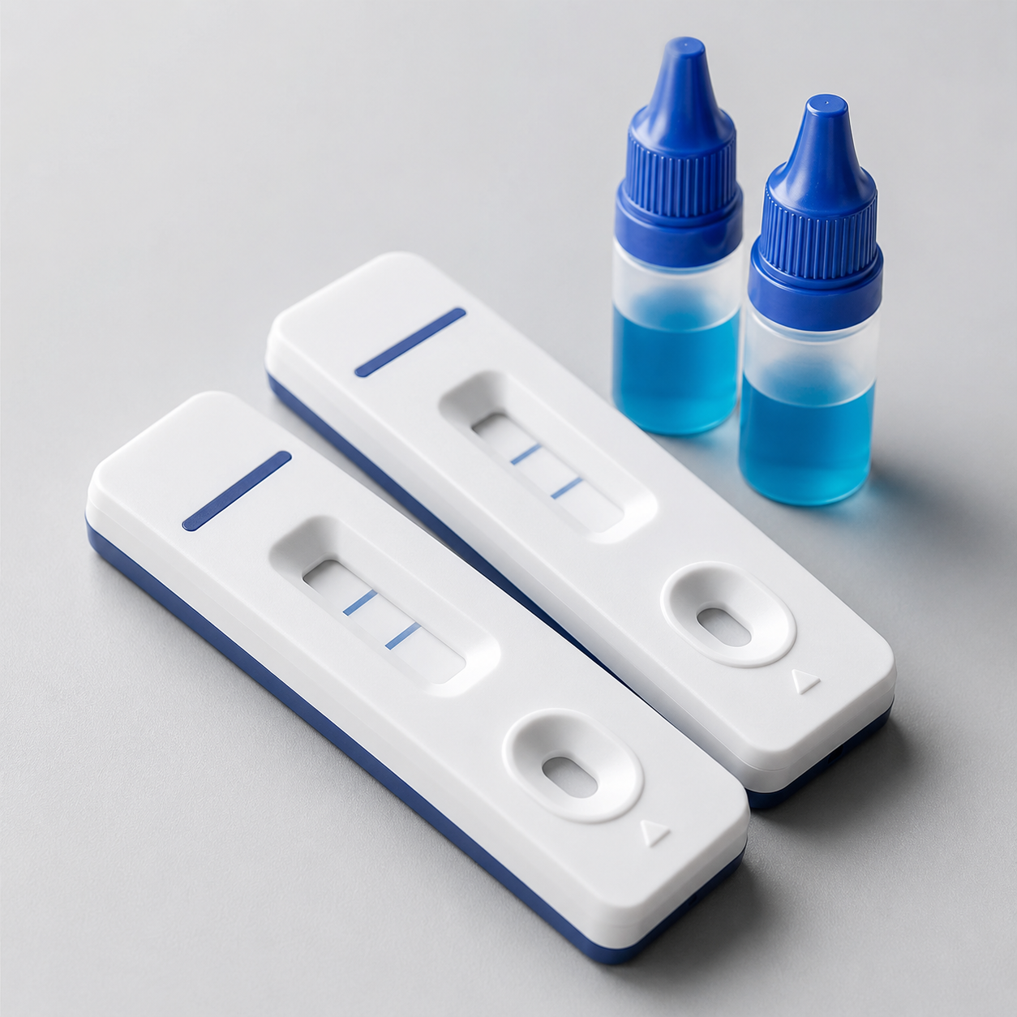

PRODUCT PLATFORM
Diversification spans the diagnostic value chain
Molecular & extraction
Immunodiagnostics
Adjacent applications
PCR, panels, LDT products and extraction.
LFA, FIA, ELISA and blood grouping.
Veterinary, food safety, culture media and exosomes.
VISION BIOTECHNOLOGY
04
Notes:
[Sources]
- Vision Biotechnology website and project content: https://www.visionbiotechnology.com/
- Vision Biotechnology 2026 catalog (user supplied)

Slide 5
GLOBAL FOOTPRINT
The network separates operating presence from future projects
ACTIVE / ESTABLISHED
Türkiye · Azerbaijan · Nigeria
Germany · United States · Romania
UNDER DEVELOPMENT
Saudi Arabia · Egypt
REGIONAL OFFICE
Hong Kong
VISION BIOTECHNOLOGY
05
Notes:
[Sources]
- Vision Biotechnology website and project content: https://www.visionbiotechnology.com/
- Vision Biotechnology 2026 catalog (user supplied)

Slide 6
BUSINESS MODEL
An integrated model connects capability to market access
01
02
03
04
05
06
R&D
Manufacturing
Quality & registration
Distribution
Technical support
Localization
VISION BIOTECHNOLOGY
06
Notes:
[Sources]
- Vision Biotechnology website and project content: https://www.visionbiotechnology.com/
- Vision Biotechnology 2026 catalog (user supplied)

Slide 7
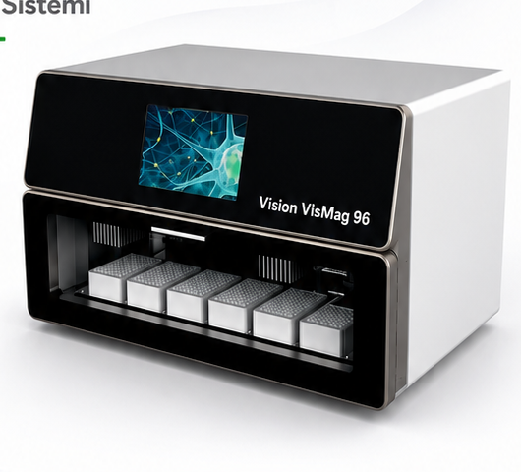
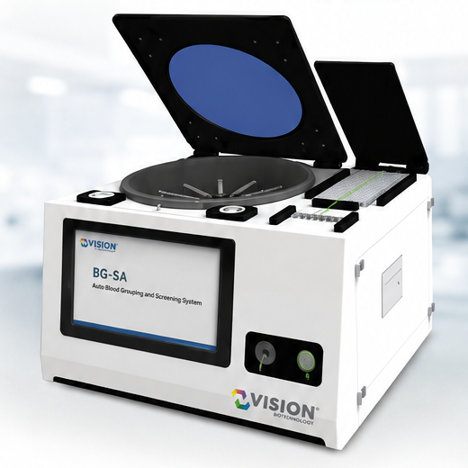
TECHNOLOGY CAPABILITIES
Manufacturing capability is reinforced by an instrument ecosystem
Kit production
Automation
Workflow integration
Molecular and immunodiagnostic product families.
VIS-MAG 32/96 and laboratory systems.
PCR, extraction and blood-grouping solutions.
VISION BIOTECHNOLOGY
07
Notes:
[Sources]
- Vision Biotechnology website and project content: https://www.visionbiotechnology.com/
- Vision Biotechnology 2026 catalog (user supplied)

Slide 8

QUALITY & REGULATORY
Regulatory development creates durable operating capability
Clinical evaluation, product documentation, quality systems and CE-IVDR development are treated as long-term platform assets. No completion claim is made beyond documented status.
VISION BIOTECHNOLOGY
08
Notes:
[Sources]
- Vision Biotechnology website and project content: https://www.visionbiotechnology.com/
- Vision Biotechnology 2026 catalog (user supplied)

Slide 9
MULTIPLE GROWTH ENGINES
Growth can come from several engines
01
Portfolio expansion
Add registered product families through existing channels.
02
New regions
Develop distributor and institutional market access.
03
OEM & private label
Use manufacturing capability in partner-led commercial models.
04
Localization
Build regional production and technology-transfer platforms.
VISION BIOTECHNOLOGY
09
Notes:
[Sources]
- Vision Biotechnology website and project content: https://www.visionbiotechnology.com/
- Vision Biotechnology 2026 catalog (user supplied)

Slide 10

LOCALIZATION MODEL
Localization turns market access into industrial capability
A qualified local partner can combine Vision-branded products, facility and line planning, technology transfer, training and quality systems within a structured project framework.
VISION BIOTECHNOLOGY
10
Notes:
[Sources]
- Vision Biotechnology website and project content: https://www.visionbiotechnology.com/
- Vision Biotechnology 2026 catalog (user supplied)

Slide 11
PARTNERSHIP STRUCTURES
Partnership structures can match strategic intent
01
Joint venture
Shared operating platform for a defined region or product scope.
02
Licensing
Controlled access to products, know-how or market rights.
03
Regional manufacturing
Local production under agreed quality and technical systems.
04
Strategic investment
Capital aligned with defined expansion and capability milestones.
VISION BIOTECHNOLOGY
11
Notes:
[Sources]
- Vision Biotechnology website and project content: https://www.visionbiotechnology.com/
- Vision Biotechnology 2026 catalog (user supplied)

Slide 12
REGIONAL EXPANSION
Regional strategies require different operating models
01
Africa
Localization, public-health readiness and regional supply capability.
02
Middle East
Local content, technology transfer and institutional market development.
03
Europe
Regulatory development, distribution and specialized partnerships.
04
Americas
Commercial partnerships, localized portfolios and workflow deployment.
VISION BIOTECHNOLOGY
12
Notes:
[Sources]
- Vision Biotechnology website and project content: https://www.visionbiotechnology.com/
- Vision Biotechnology 2026 catalog (user supplied)

Slide 13
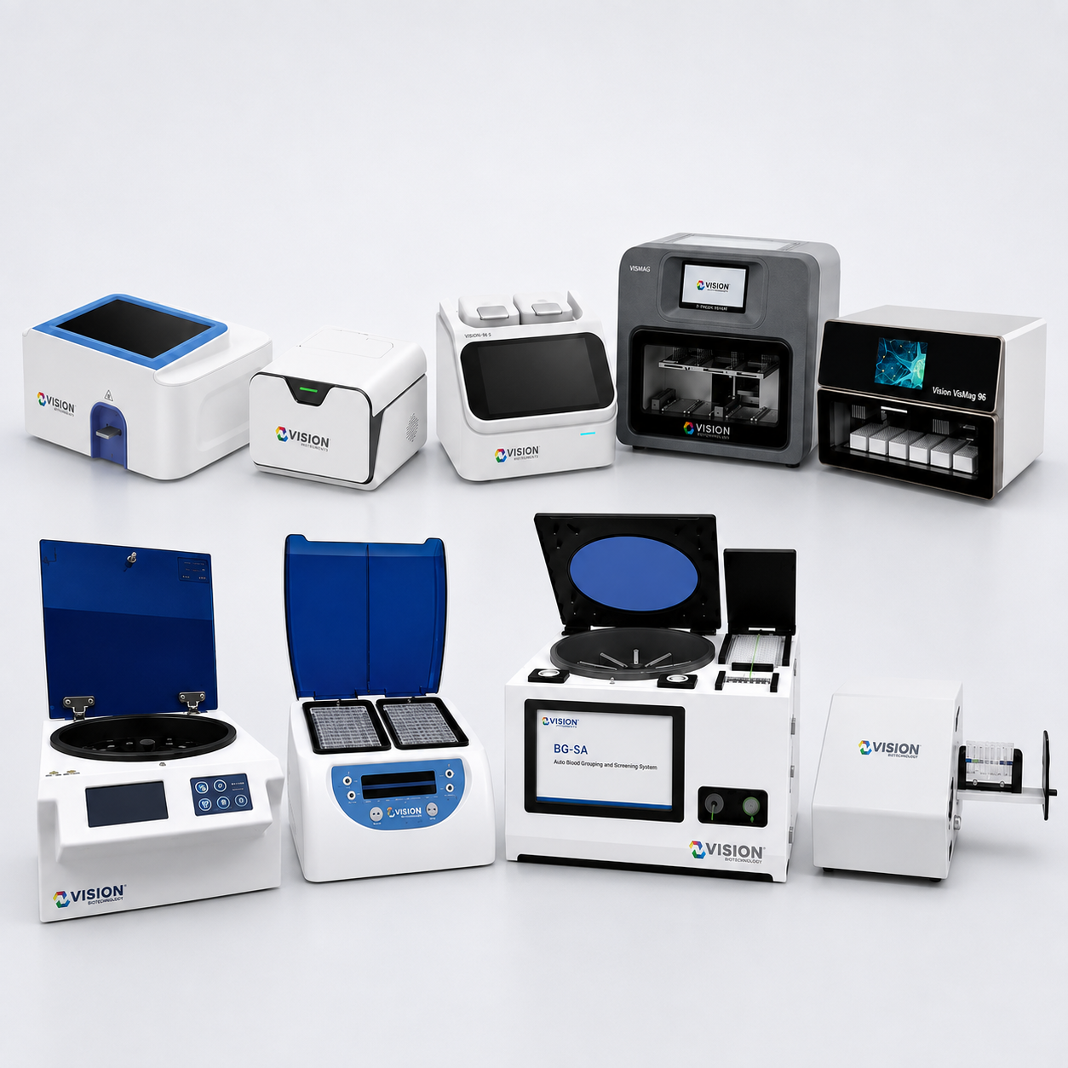
PLATFORM SYNERGY
Platform components reinforce one another
Tests drive workflows
Systems create continuity
Localization deepens value
PCR, rapid, immunoassay and blood grouping.
Extraction and instrument platforms support repeat use.
Training, quality and production expand regional capability.
VISION BIOTECHNOLOGY
13
Notes:
[Sources]
- Vision Biotechnology website and project content: https://www.visionbiotechnology.com/
- Vision Biotechnology 2026 catalog (user supplied)

Slide 14
STRATEGIC ADVANTAGES
Strategic advantages are operational—not hypothetical
01
Diversified portfolio
Fourteen categories reduce dependence on a single modality.
02
Technical adaptability
Products and workflows can be configured for different market needs.
03
Localization experience
The model includes facility, transfer, training and quality support.
04
Clear status discipline
Operating entities and development projects are presented separately.
VISION BIOTECHNOLOGY
14
Notes:
[Sources]
- Vision Biotechnology website and project content: https://www.visionbiotechnology.com/
- Vision Biotechnology 2026 catalog (user supplied)

Slide 15
VALUE CREATION ROADMAP
Value creation progresses through capability milestones
01
02
03
04
05
Strengthen core portfolio
Deepen registrations
Scale partner channels
Localize production
Expand regional platforms
VISION BIOTECHNOLOGY
15
Notes:
[Sources]
- Vision Biotechnology website and project content: https://www.visionbiotechnology.com/
- Vision Biotechnology 2026 catalog (user supplied)

Slide 16
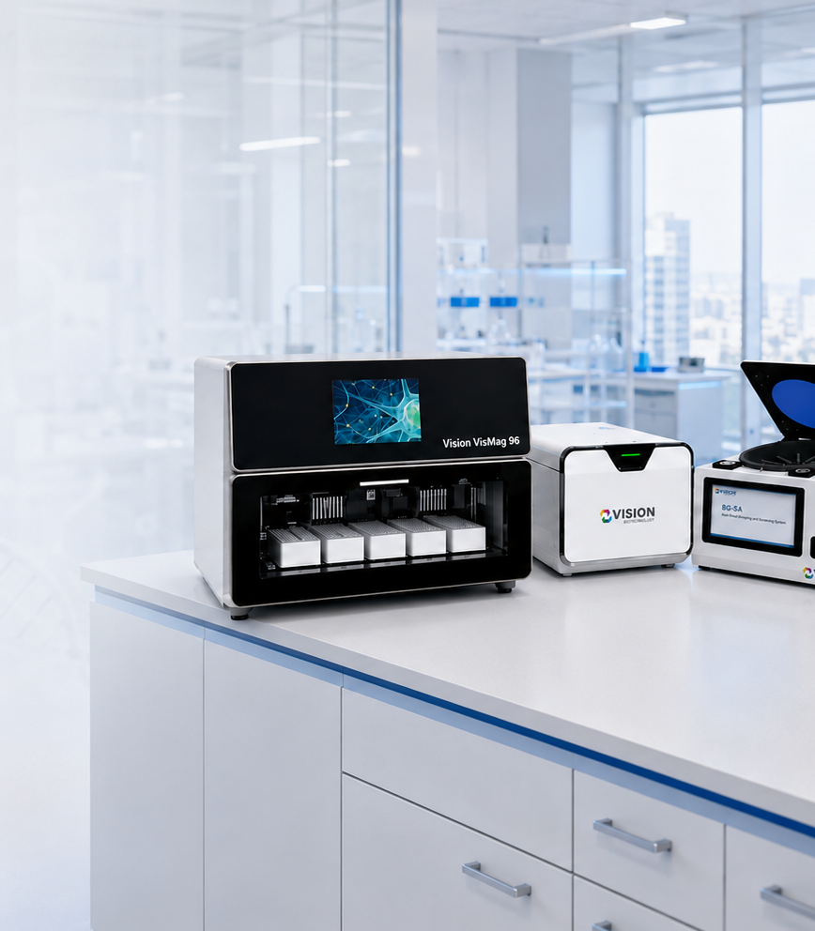
PARTNERSHIP OPPORTUNITY
Partners can enter at several points in the platform
Strategic participation may focus on distribution, product registration, manufacturing infrastructure, technology transfer, regional operations or long-term platform investment.
VISION BIOTECHNOLOGY
16
Notes:
[Sources]
- Vision Biotechnology website and project content: https://www.visionbiotechnology.com/
- Vision Biotechnology 2026 catalog (user supplied)

Slide 17
Build the Next Regional Diagnostics Platform with Vision
A partnership framework grounded in products, quality systems and local capability.
info@visionbiotechnology.com
visionbiotechnology.com
Notes:
[Sources]
- Vision Biotechnology website and project content: https://www.visionbiotechnology.com/
- Vision Biotechnology 2026 catalog (user supplied)

