Slide 1
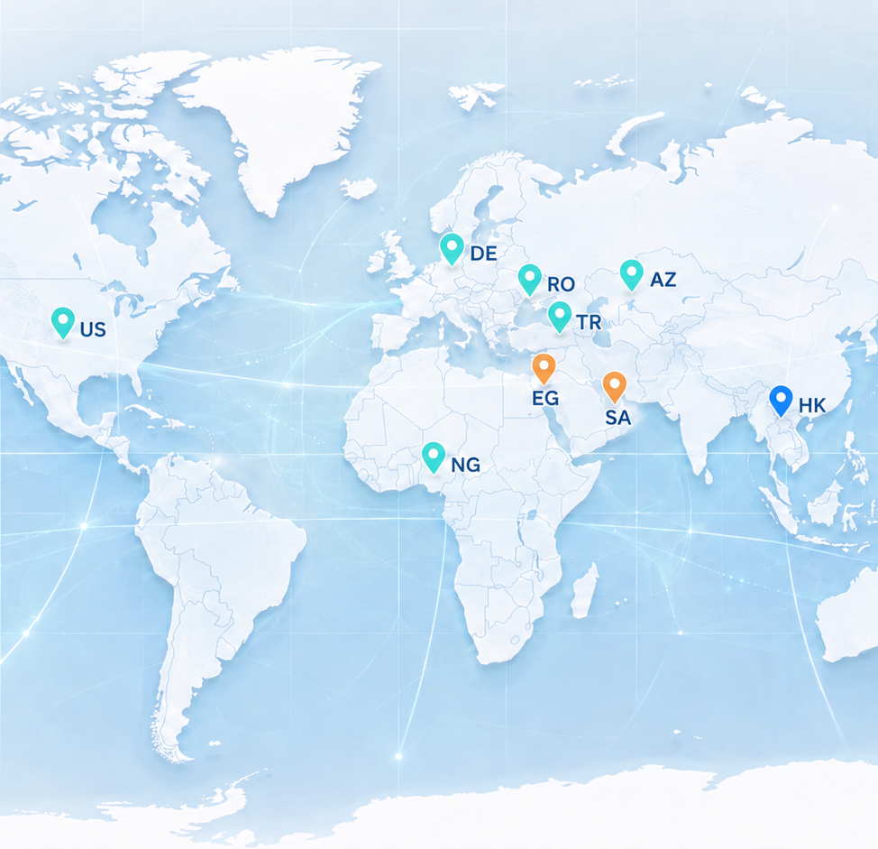

A Stronger Diagnostic Portfolio for Your Market
Products, systems and support designed to grow together.
visionbiotechnology.com
Notes:
[Sources]
- Vision Biotechnology website and project content: https://www.visionbiotechnology.com/
- Vision Biotechnology 2026 catalog (user supplied)

Slide 2
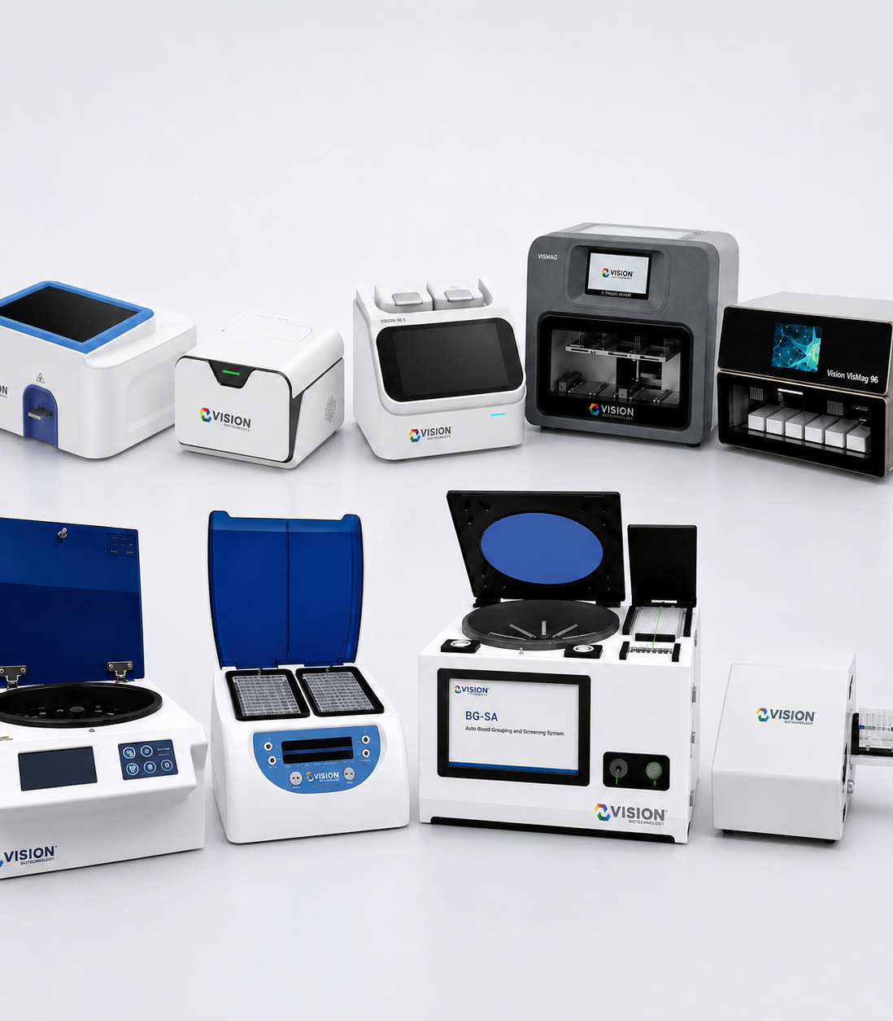
PORTFOLIO ADVANTAGE
One partner can open multiple customer doors
A distributor can address molecular laboratories, hospitals, blood banks, veterinary customers, food laboratories and research users through one coordinated product platform.
VISION BIOTECHNOLOGY
02
Notes:
[Sources]
- Vision Biotechnology website and project content: https://www.visionbiotechnology.com/
- Vision Biotechnology 2026 catalog (user supplied)

Slide 3
CUSTOMER COVERAGE
Match the portfolio to each customer segment
01
Hospitals & laboratories
PCR, extraction, FIA, ELISA and clinical laboratory products.
02
Blood banks
Gel cards, Vision BG-SA and supporting instruments.
03
Veterinary channels
Diagnostic equipment, analyzers, rapid tests and pet-care products.
04
Food & industry
Food-safety diagnostics, agricultural biotechnology and culture media.
VISION BIOTECHNOLOGY
03
Notes:
[Sources]
- Vision Biotechnology website and project content: https://www.visionbiotechnology.com/
- Vision Biotechnology 2026 catalog (user supplied)

Slide 4
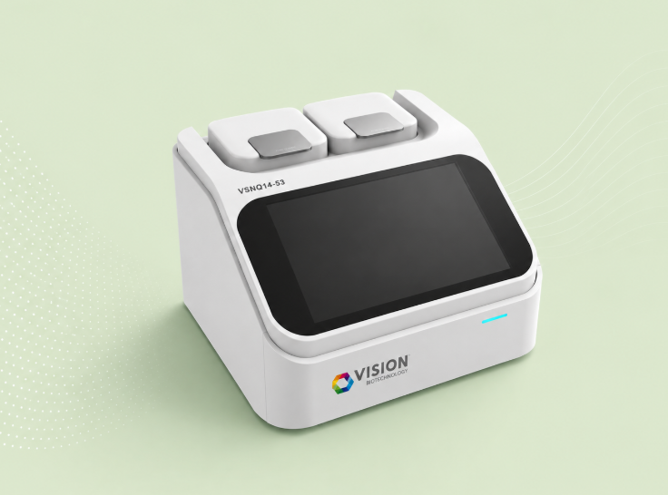

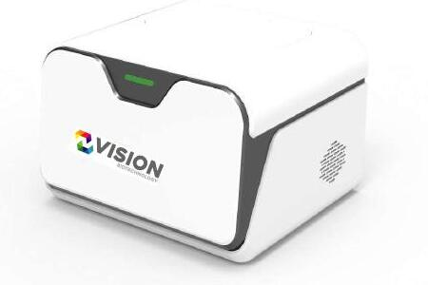
PCR COMMERCIAL PLATFORM
Molecular diagnostics create a scalable core portfolio
Real-Time PCR
Panel PCR
LDT PCR
Routine single-target assays.
Multiplex and syndromic portfolios.
Specialized laboratory workflows.
VISION BIOTECHNOLOGY
04
Notes:
[Sources]
- Vision Biotechnology website and project content: https://www.visionbiotechnology.com/
- Vision Biotechnology 2026 catalog (user supplied)

Slide 5
CONNECTED SYSTEM
Offer a complete extraction-to-result workflow
01
02
03
04
05
Sample preparation
VIS-MAG extraction
PCR setup
Amplification
Technical review
VISION BIOTECHNOLOGY
05
Notes:
[Sources]
- Vision Biotechnology website and project content: https://www.visionbiotechnology.com/
- Vision Biotechnology 2026 catalog (user supplied)

Slide 6
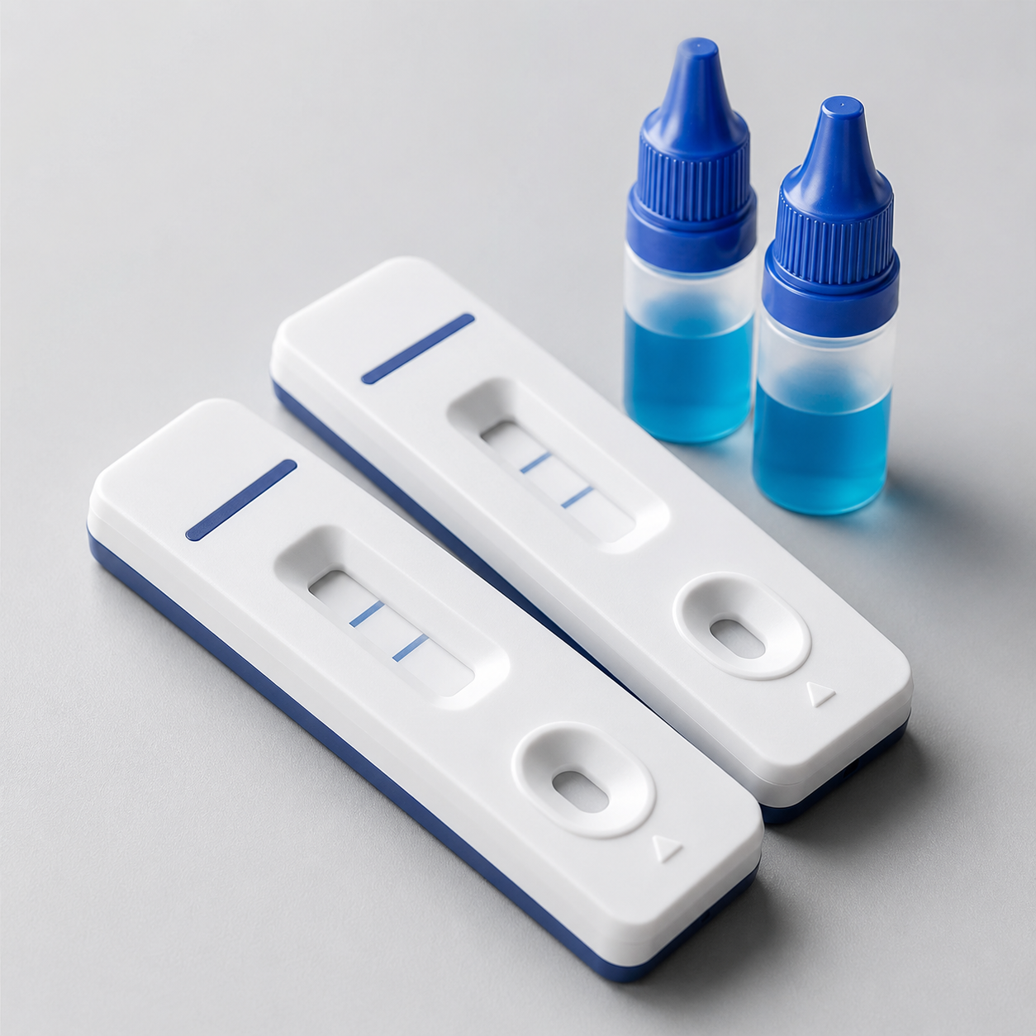


LFA PORTFOLIO
Rapid testing broadens access across customer types
Infectious disease
Specialty screening
Veterinary rapid tests
Rapid point-of-need categories.
Fertility, drugs, cardiac and gastrointestinal groups.
Additional growth through animal-health channels.
VISION BIOTECHNOLOGY
06
Notes:
[Sources]
- Vision Biotechnology website and project content: https://www.visionbiotechnology.com/
- Vision Biotechnology 2026 catalog (user supplied)

Slide 7
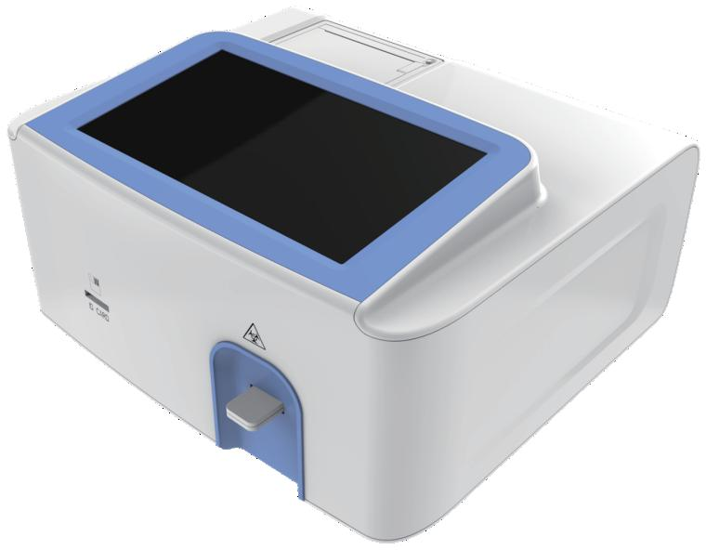
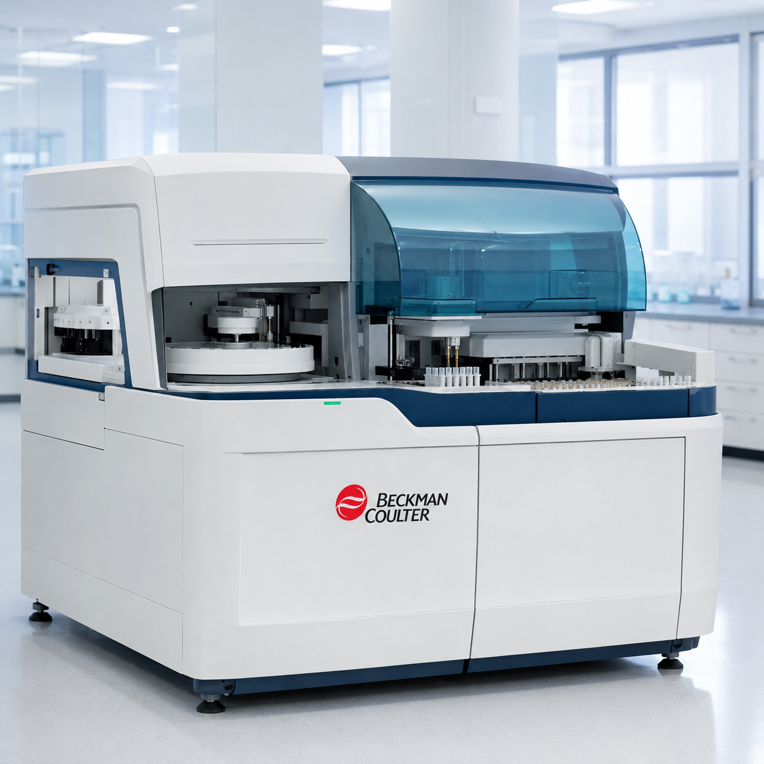

LABORATORY BREADTH
Complementary assays increase account value
VI-FA
ELISA
Biochemistry & hormones
Fluorescence immunoassay workflow.
Laboratory immunoassay portfolio.
Complementary routine-laboratory categories.
VISION BIOTECHNOLOGY
07
Notes:
[Sources]
- Vision Biotechnology website and project content: https://www.visionbiotechnology.com/
- Vision Biotechnology 2026 catalog (user supplied)

Slide 8
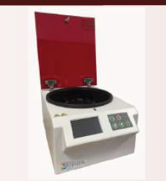
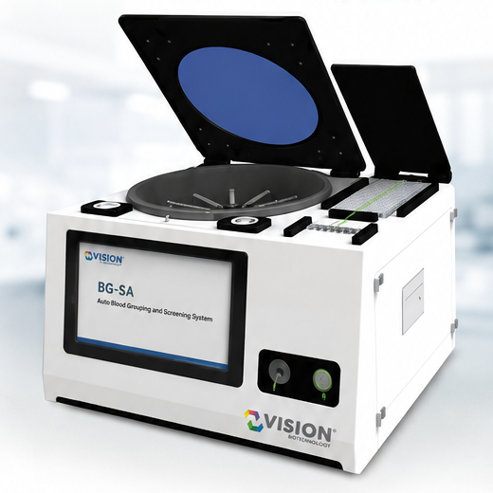
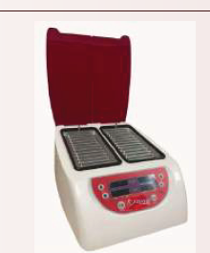
BLOOD BANK SOLUTIONS
A complete blood-grouping proposition
Gel cards
Vision BG-SA
Bench instruments
Consumables for grouping and screening.
Automated system for integrated workflows.
Reader, incubator and centrifuge support.
VISION BIOTECHNOLOGY
08
Notes:
[Sources]
- Vision Biotechnology website and project content: https://www.visionbiotechnology.com/
- Vision Biotechnology 2026 catalog (user supplied)

Slide 9
ADJACENT MARKETS
Veterinary and food safety add new growth lanes
Vision enables distributors to build beyond a single human-IVD category, using veterinary diagnostics and food-safety solutions to reach additional professional customers.
VISION BIOTECHNOLOGY
09
Notes:
[Sources]
- Vision Biotechnology website and project content: https://www.visionbiotechnology.com/
- Vision Biotechnology 2026 catalog (user supplied)

Slide 10
COMMERCIAL FLEXIBILITY
Commercial models adapt to the market
01
Distribution
Country or territory-focused portfolio development.
02
OEM / private label
Defined product groups aligned with local brand strategy.
03
Portfolio bundles
Category combinations selected around customer demand.
04
Localization
Technology-transfer pathways for qualified regional partners.
VISION BIOTECHNOLOGY
10
Notes:
[Sources]
- Vision Biotechnology website and project content: https://www.visionbiotechnology.com/
- Vision Biotechnology 2026 catalog (user supplied)

Slide 11

REGULATORY SUPPORT
Documentation support reduces launch friction
Product-registration files, technical documents, IFUs and application materials can be organized around the selected portfolio and local submission pathway.
VISION BIOTECHNOLOGY
11
Notes:
[Sources]
- Vision Biotechnology website and project content: https://www.visionbiotechnology.com/
- Vision Biotechnology 2026 catalog (user supplied)

Slide 12
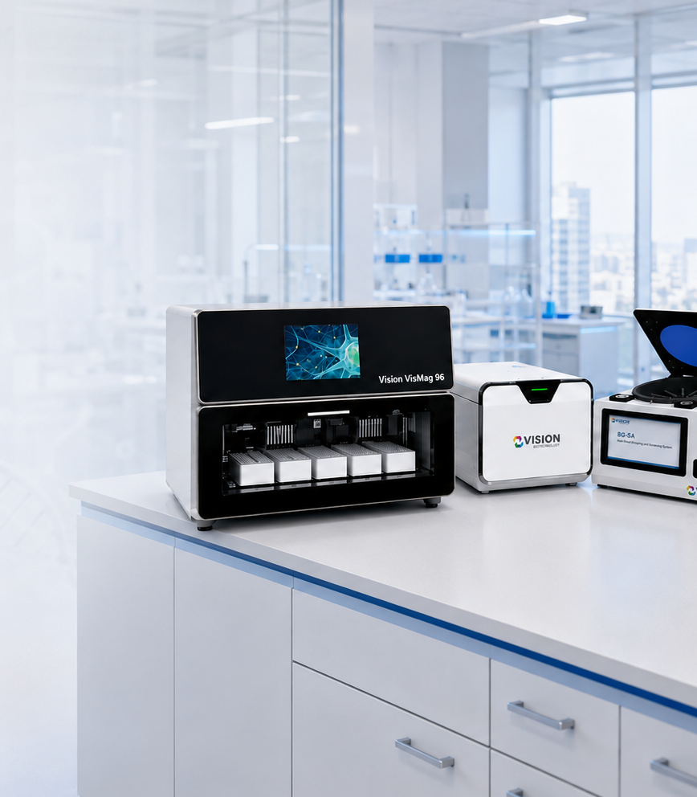
APPLICATION SUPPORT
Training continues after the shipment
Installation planning, user training, application support and structured technical case intake help distributors protect customer confidence after market launch.
VISION BIOTECHNOLOGY
12
Notes:
[Sources]
- Vision Biotechnology website and project content: https://www.visionbiotechnology.com/
- Vision Biotechnology 2026 catalog (user supplied)

Slide 13
MARKET LAUNCH MODEL
Launch the right products in the right sequence
01
02
03
04
05
Select portfolio
Prepare registration
Train the team
Launch accounts
Support & expand
VISION BIOTECHNOLOGY
13
Notes:
[Sources]
- Vision Biotechnology website and project content: https://www.visionbiotechnology.com/
- Vision Biotechnology 2026 catalog (user supplied)

Slide 14
PARTNER VALUE
Why distributors choose Vision
01
Category breadth
Build more than one revenue stream with one manufacturer relationship.
02
System workflows
Connect extraction, testing, instruments and technical support.
03
Market flexibility
Shape the portfolio around registration and customer priorities.
04
Growth pathway
Expand into OEM, localization or technology transfer when justified.
VISION BIOTECHNOLOGY
14
Notes:
[Sources]
- Vision Biotechnology website and project content: https://www.visionbiotechnology.com/
- Vision Biotechnology 2026 catalog (user supplied)

Slide 15

PARTNERSHIP PROPOSAL
Build a proposal around your country
Define the target customers, priority product families, registration pathway and expected support model. Vision can then structure a focused commercial and technical work plan.
VISION BIOTECHNOLOGY
15
Notes:
[Sources]
- Vision Biotechnology website and project content: https://www.visionbiotechnology.com/
- Vision Biotechnology 2026 catalog (user supplied)

Slide 16
Let’s Build Your Market Together
Select the portfolio. Prepare the pathway. Support the customer.
info@visionbiotechnology.com
visionbiotechnology.com
Notes:
[Sources]
- Vision Biotechnology website and project content: https://www.visionbiotechnology.com/
- Vision Biotechnology 2026 catalog (user supplied)

