Slide 1
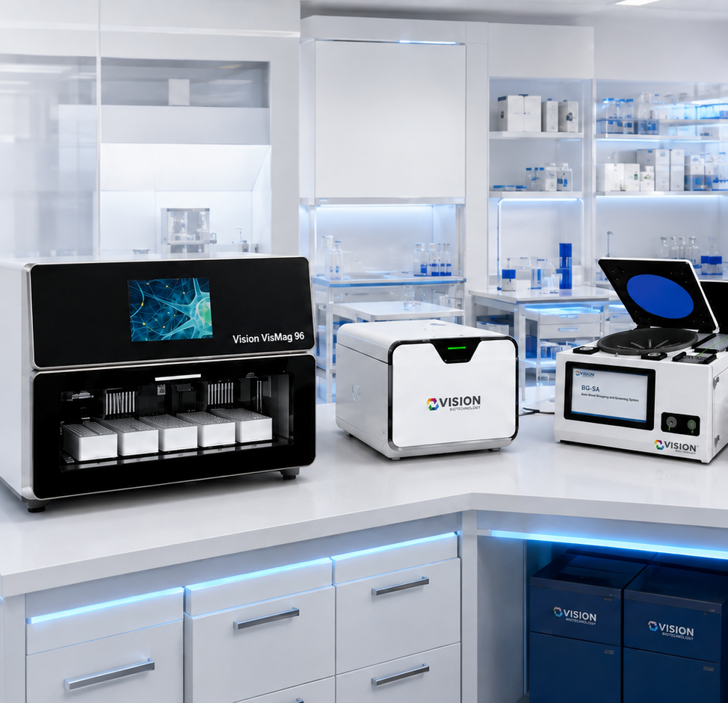

Vision Biotechnology
Integrated Diagnostics. Global Reach.
visionbiotechnology.com
Notes:
[Sources]
- Vision Biotechnology website and project content: https://www.visionbiotechnology.com/
- Vision Biotechnology 2026 catalog (user supplied)

Slide 2
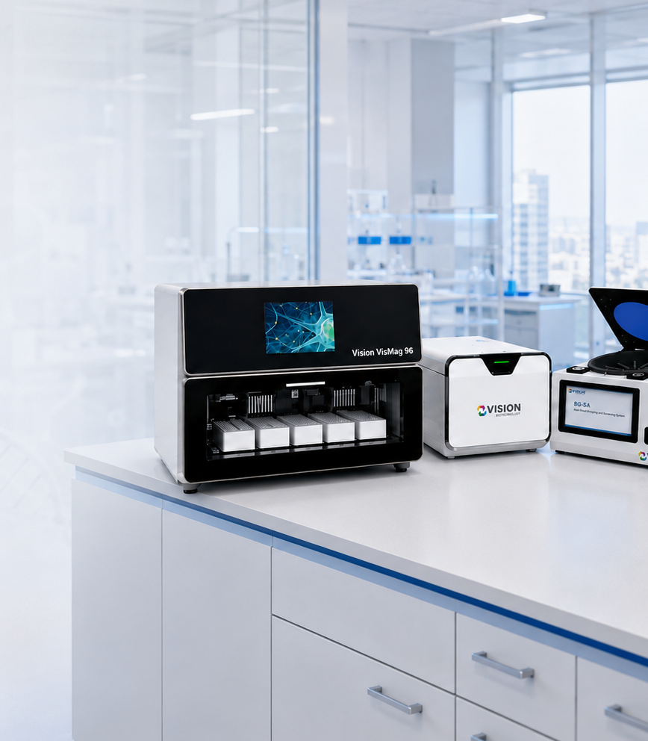
WHO WE ARE
An integrated biotechnology platform
Vision Biotechnology connects molecular diagnostics, rapid testing, extraction, immunodiagnostics, blood grouping, laboratory systems, veterinary diagnostics and food-safety solutions within one coordinated platform.
VISION BIOTECHNOLOGY
02
Notes:
[Sources]
- Vision Biotechnology website and project content: https://www.visionbiotechnology.com/
- Vision Biotechnology 2026 catalog (user supplied)

Slide 3

WHY DIAGNOSTICS MATTER
Diagnosis shapes better outcomes
Reliable diagnostic pathways support earlier decisions, stronger laboratory workflows and better preparedness across human health, animal health and food safety.
VISION BIOTECHNOLOGY
03
Notes:
[Sources]
- Vision Biotechnology website and project content: https://www.visionbiotechnology.com/
- Vision Biotechnology 2026 catalog (user supplied)

Slide 4
OUR JOURNEY
Built through disciplined expansion, 2012–2026
2012
2018
2023
Founded in İstanbul, Kadıköy
IVD & molecular diagnostics
Veterinary diagnostics
2015
2020
2026
Domestic food-safety tests
COVID-19 RT-PCR & exports
Localization network
VISION BIOTECHNOLOGY
04
Notes:
[Sources]
- Vision Biotechnology website and project content: https://www.visionbiotechnology.com/
- Vision Biotechnology 2026 catalog (user supplied)

Slide 5
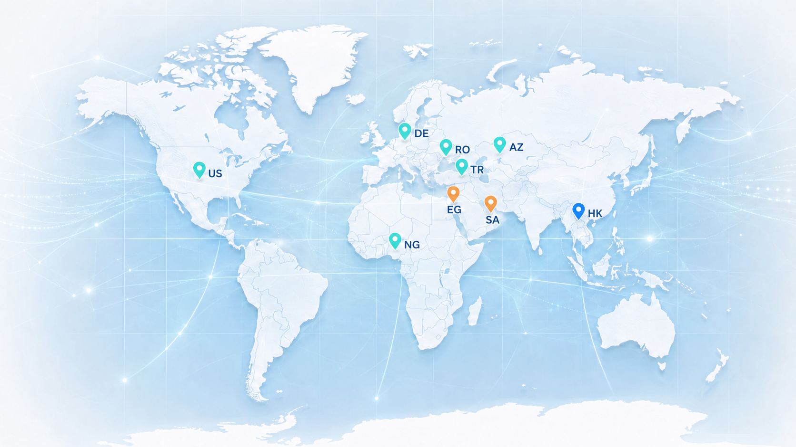
GLOBAL FOOTPRINT
A global network—without blurring project status
ACTIVE / ESTABLISHED
Türkiye · Azerbaijan · Nigeria
Germany · United States · Romania
UNDER DEVELOPMENT
Saudi Arabia · Egypt
REGIONAL OFFICE
Hong Kong
VISION BIOTECHNOLOGY
05
Notes:
[Sources]
- Vision Biotechnology website and project content: https://www.visionbiotechnology.com/
- Vision Biotechnology 2026 catalog (user supplied)

Slide 6
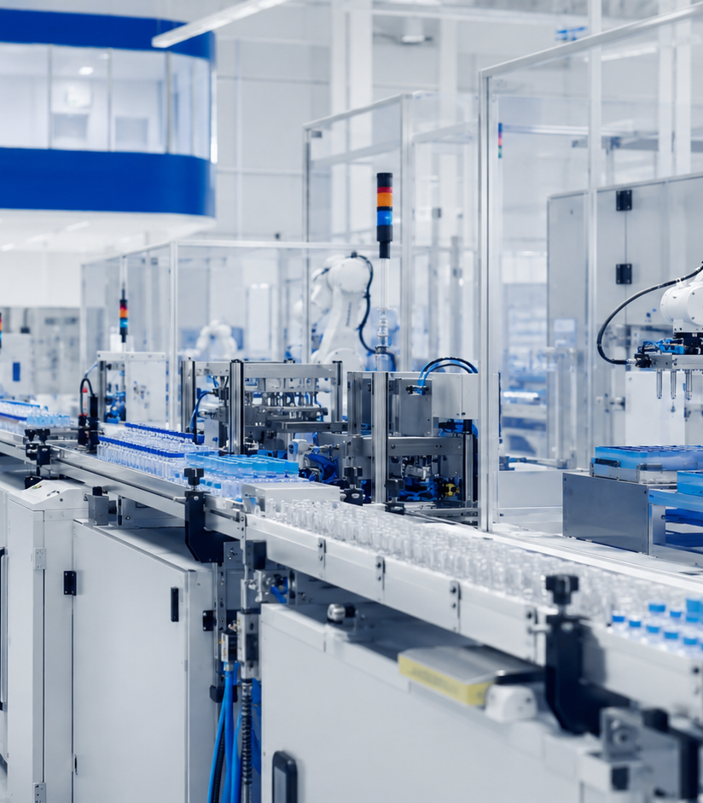
CAPABILITIES
R&D and manufacturing work as one system
Product development, controlled manufacturing, quality documentation and application support are designed to move together—reducing the distance between an idea, a validated workflow and market deployment.
VISION BIOTECHNOLOGY
06
Notes:
[Sources]
- Vision Biotechnology website and project content: https://www.visionbiotechnology.com/
- Vision Biotechnology 2026 catalog (user supplied)

Slide 7
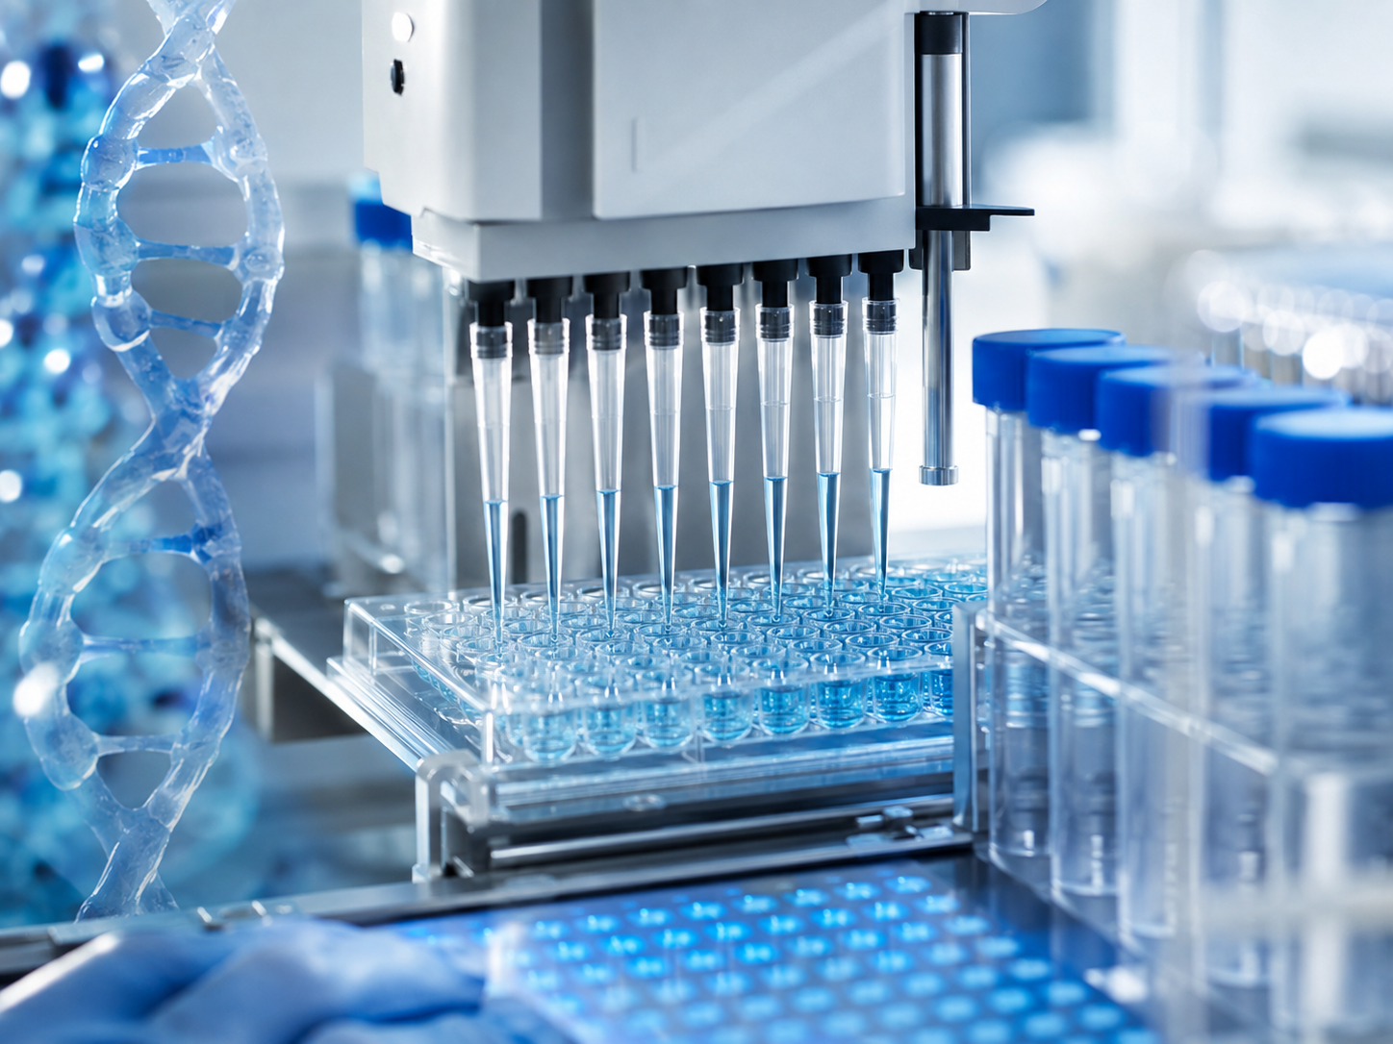
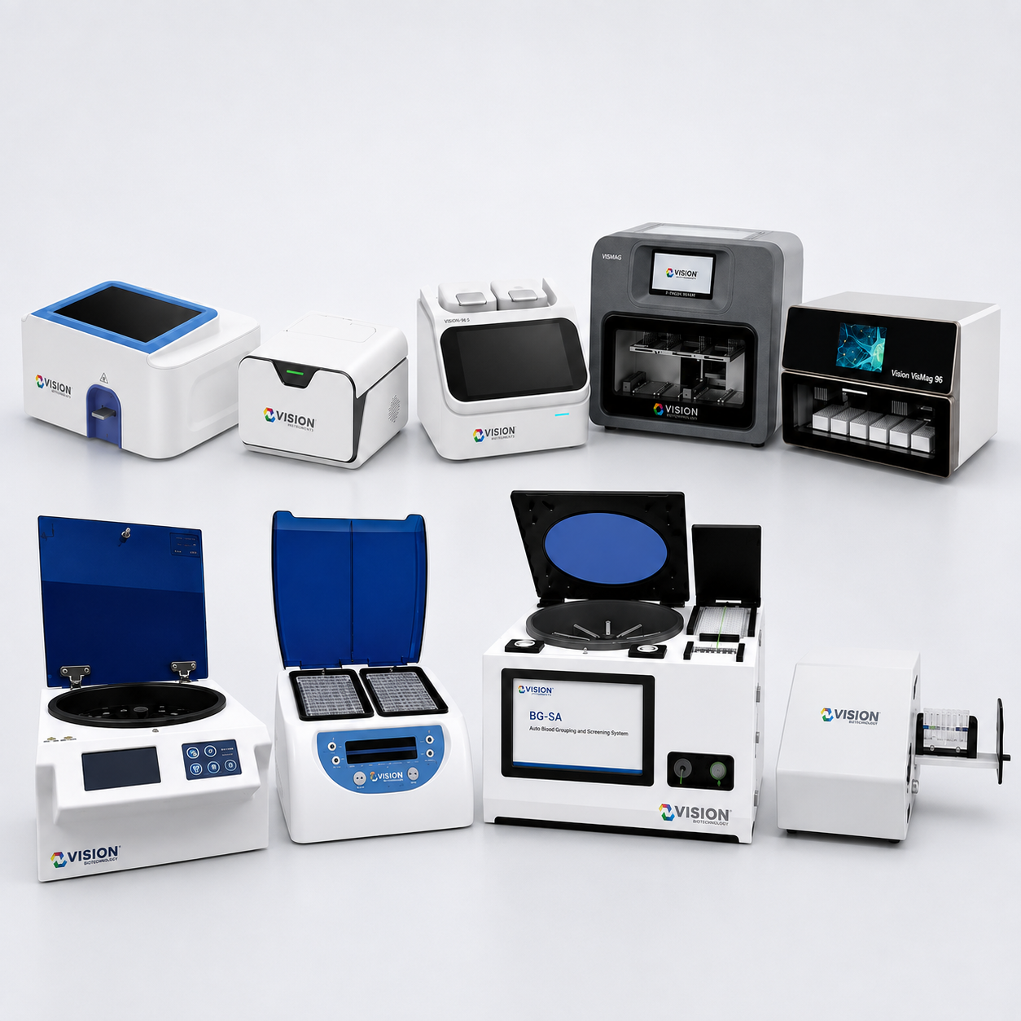
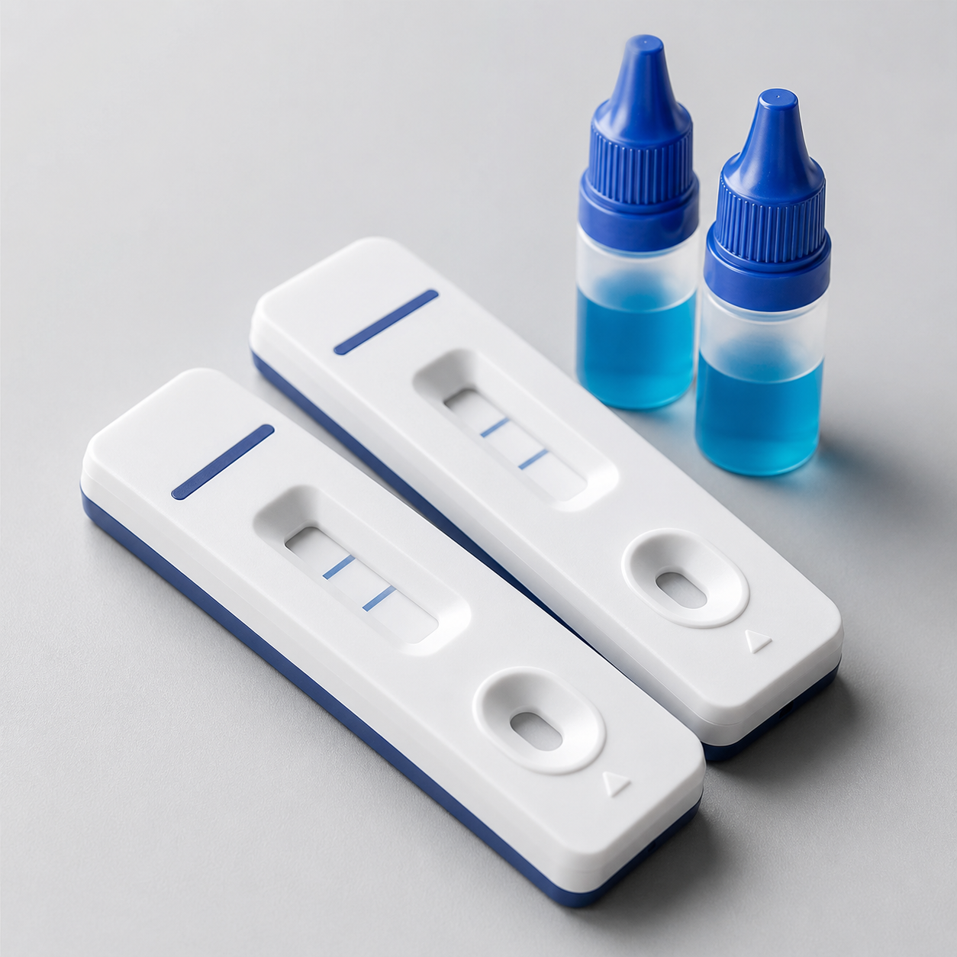
PRODUCT ECOSYSTEM
One portfolio, multiple diagnostic pathways
Molecular diagnostics
Extraction & systems
Immunodiagnostics
Real-time, panel-type and LDT-type PCR solutions.
Manual and automated extraction with instrument workflows.
LFA, FIA, ELISA, biochemistry and hormone testing.
VISION BIOTECHNOLOGY
07
Notes:
[Sources]
- Vision Biotechnology website and project content: https://www.visionbiotechnology.com/
- Vision Biotechnology 2026 catalog (user supplied)

Slide 8
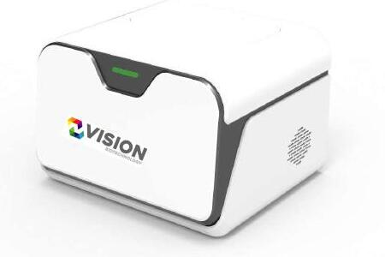
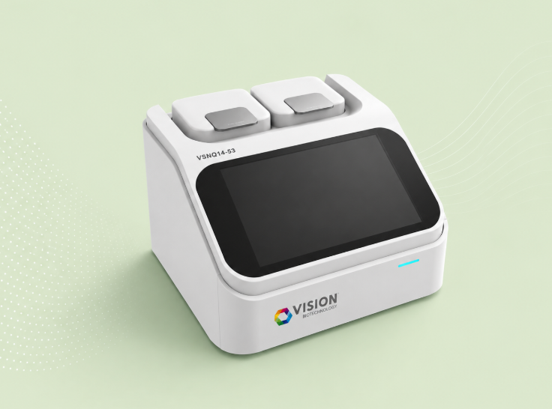
PCR PORTFOLIO
Molecular diagnostics built for varied workflows
Real-Time PCR
Panel-Type PCR
LDT-Type PCR
Single-target qualitative and quantitative assays.
Multiplex and syndromic testing workflows.
Laboratory-developed testing configurations.
VISION BIOTECHNOLOGY
08
Notes:
[Sources]
- Vision Biotechnology website and project content: https://www.visionbiotechnology.com/
- Vision Biotechnology 2026 catalog (user supplied)

Slide 9
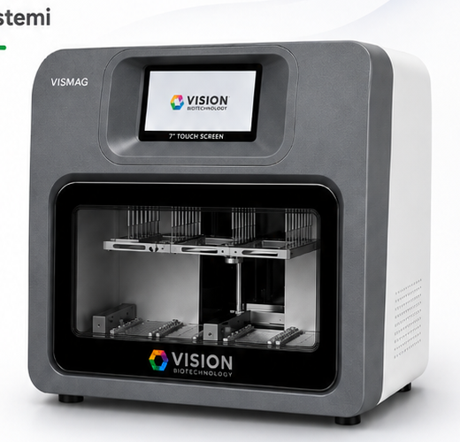
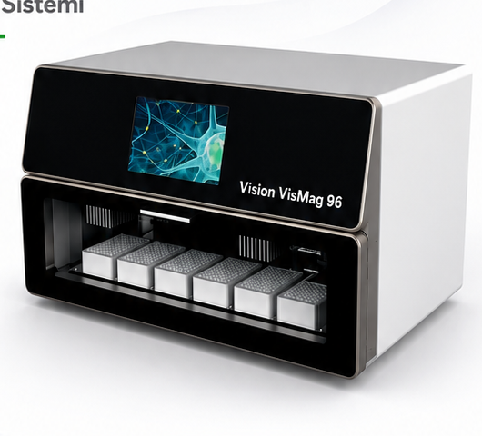
SYSTEMS
Extraction and instruments form a complete ecosystem
VIS-MAG 32
VIS-MAG 96
Vision PCR systems
Automated nucleic acid extraction platform.
Higher-throughput extraction workflow.
Vision 19-23Q and Vision 14-53Q.
VISION BIOTECHNOLOGY
09
Notes:
[Sources]
- Vision Biotechnology website and project content: https://www.visionbiotechnology.com/
- Vision Biotechnology 2026 catalog (user supplied)

Slide 10
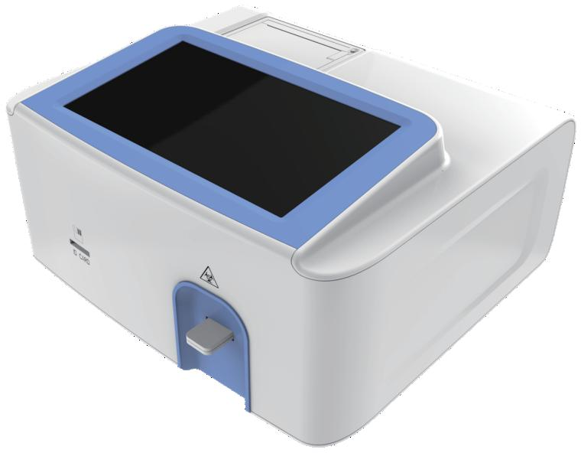
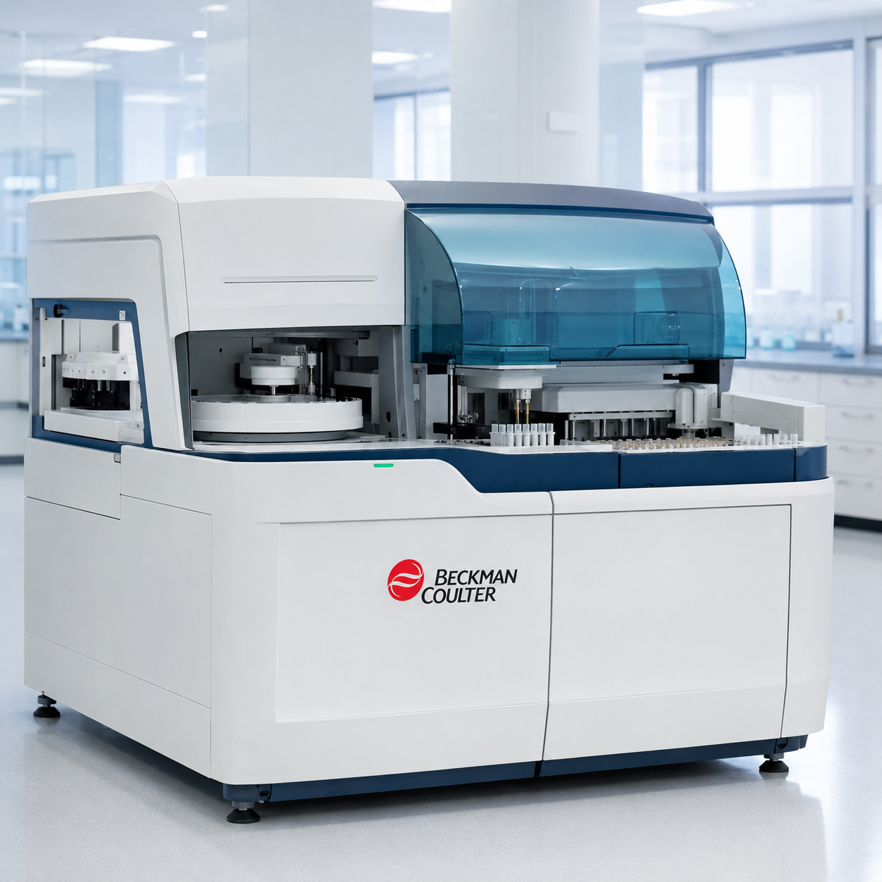
IMMUNODIAGNOSTICS
Rapid and immunodiagnostic solutions extend laboratory reach
LFA rapid tests
VI-FA
Clinical laboratory
Broad rapid-testing categories.
Fluorescence immunoassay platform.
ELISA, biochemistry and hormone portfolios.
VISION BIOTECHNOLOGY
10
Notes:
[Sources]
- Vision Biotechnology website and project content: https://www.visionbiotechnology.com/
- Vision Biotechnology 2026 catalog (user supplied)

Slide 11
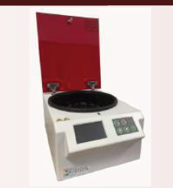
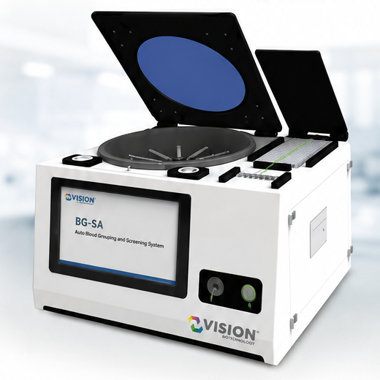
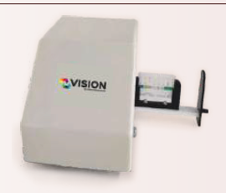
IMMUNOHEMATOLOGY
Blood grouping combines consumables with automation
Gel card systems
Vision BG-SA
Supporting instruments
Blood grouping and screening workflows.
Automated blood grouping and screening system.
Centrifuge, incubator and reader.
VISION BIOTECHNOLOGY
11
Notes:
[Sources]
- Vision Biotechnology website and project content: https://www.visionbiotechnology.com/
- Vision Biotechnology 2026 catalog (user supplied)

Slide 12
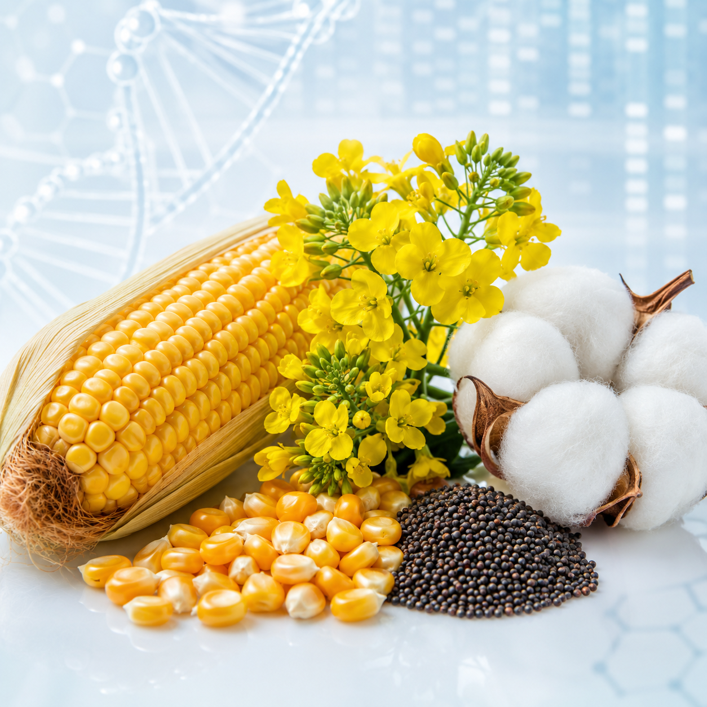


EXPANDED BIOTECHNOLOGY
Beyond human diagnostics
Veterinary diagnostics
Food safety
Advanced applications
Diagnostics and care products for animal health.
Food and agricultural biotechnology solutions.
Ready-to-use culture media and exosome products.
VISION BIOTECHNOLOGY
12
Notes:
[Sources]
- Vision Biotechnology website and project content: https://www.visionbiotechnology.com/
- Vision Biotechnology 2026 catalog (user supplied)

Slide 13

QUALITY & REGULATORY
Quality is a development discipline
Vision maintains quality-management and technical-documentation pathways while advancing CE-IVDR work with G-Med. Regulatory status is represented by documented evidence—not by assumption.
VISION BIOTECHNOLOGY
13
Notes:
[Sources]
- Vision Biotechnology website and project content: https://www.visionbiotechnology.com/
- Vision Biotechnology 2026 catalog (user supplied)

Slide 14
OEM & TECHNOLOGY TRANSFER
Localization converts know-how into regional capability
01
02
03
04
05
Portfolio selection
Facility & line design
Technology transfer
Training & quality
Local scale-up
VISION BIOTECHNOLOGY
14
Notes:
[Sources]
- Vision Biotechnology website and project content: https://www.visionbiotechnology.com/
- Vision Biotechnology 2026 catalog (user supplied)

Slide 15
A COORDINATED PLATFORM
Why Vision Biotechnology
01
Breadth without fragmentation
Fourteen product categories linked by one technical and quality approach.
02
Workflow thinking
Kits, extraction, instruments and support are designed as connected systems.
03
Localization capability
OEM, private-label and regional manufacturing models support market-specific needs.
04
Global operating perspective
Active entities, regional offices and development projects are clearly separated.
VISION BIOTECHNOLOGY
15
Notes:
[Sources]
- Vision Biotechnology website and project content: https://www.visionbiotechnology.com/
- Vision Biotechnology 2026 catalog (user supplied)

Slide 16
Integrated diagnostics. Built to work together.
Explore products, localization opportunities and institutional partnerships.
info@visionbiotechnology.com
visionbiotechnology.com
Notes:
[Sources]
- Vision Biotechnology website and project content: https://www.visionbiotechnology.com/
- Vision Biotechnology 2026 catalog (user supplied)

